Slide 1
Renewing Sectionalism: Compromise of 1850, the Kansas-Nebraska Act, and Legislating Slavery
Mr. Winchell
APUSH
Period 5

Slide 2
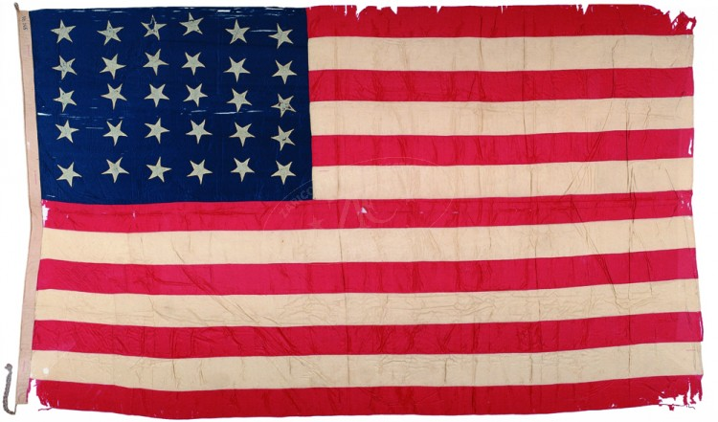
Renewing Sectionalism
Issues around Western Expansion
Wilmot Proviso
Popular Sovereignty
California Gold Rush
More tensions over Slavery
Underground Railroad
The Compromise of 1850
Fugitive Slave Act
Kansas-Nebraska Act

Slide 3
Quote Reflection…
“The United States will conquer Mexico, but it will be as the man swallows arsenic…Mexico will poison us.”
Ralph Waldo Emerson

Slide 4
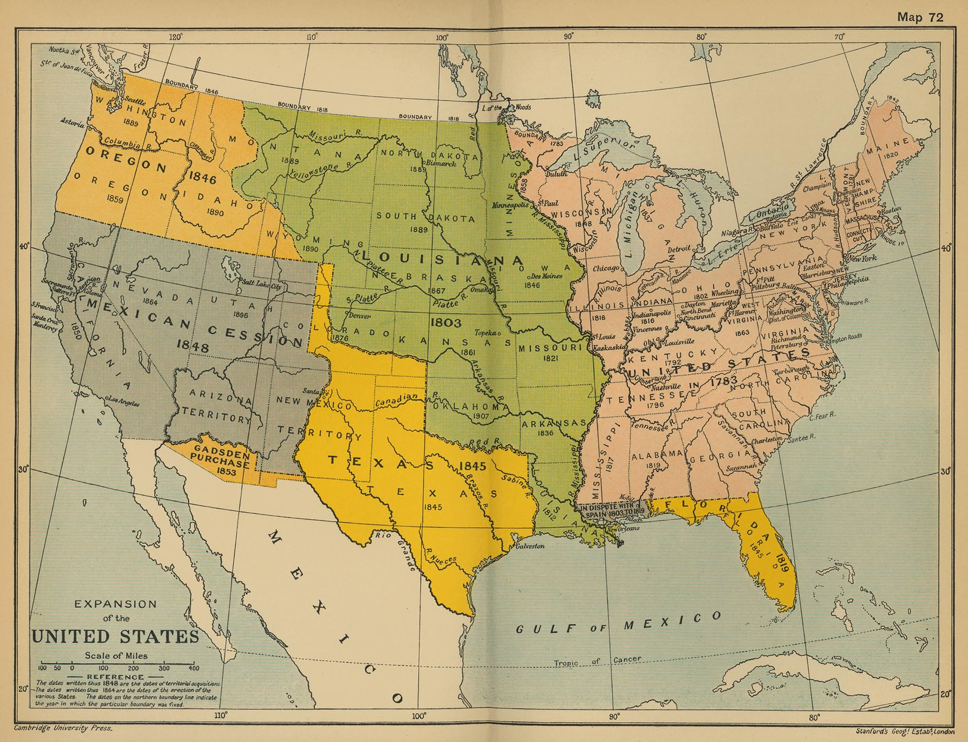
A Review…
Mexican-American War and the Treaty of Guadeloupe-Hidalgo…
New Territory = huge population movement out west.
Creates tension in DC! – over FREE vs SLAVE state.
Oh wait…no worries, we have the 36-30 line from the Missouri Compromise.
However, there is CA…Uh oh!
Attempted Solution: The Wilmot proviso – no slavery allowed in territories from the M-A War.
Never passed – came to represent Northern anti-slavery sentiment.
Balance of power and stability of the Union is now in question!
???

Slide 5
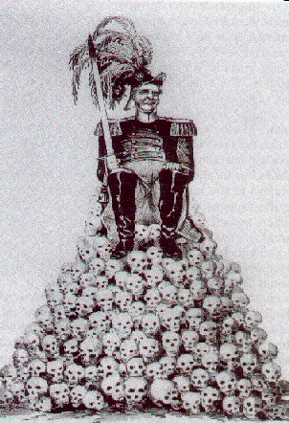
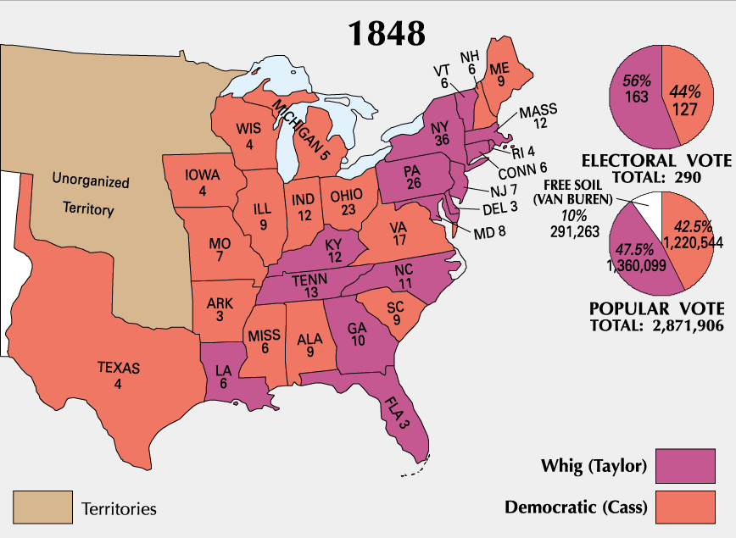
Election of 1848
Polk – in poor health and won’t run again - Democrats nominated Lewis Cass.
Whigs nominated General Zachary Taylor (the hero of the Mexican War - no political experience).
Anti-slavery advocates – neither are liked…formed the Free Soil Party (nominating Martin Van Buren).
Only received 10% of the vote - would lead to the collapse of the 2nd party system in the 1850’s.
1st Party System - Federalists and Republicans
2nd Party System - Democrats and Whigs
3rd (current) Party System - Democrats and Republicans

Slide 6
Democrats vs. Whigs
America’s 2nd Party System
Democrats Whigs
“Common Man” “Professional/Business Class”
Common Workers Doctors/Lawyers/Merchants/Banker
Factory Workers Factory Owners
Small/Poor Farmers Commercial/Plantation Planters
NOT DIVIDED BY GEOGRAPHY….UNTIL THE ISSUE OF SLAVERY

Slide 7
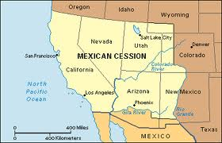
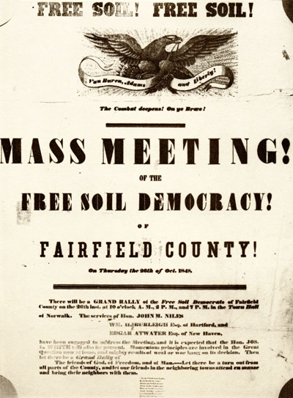
Sectionalism over Slavery: Ideas on How to Fix It??
Remember…the land from M-A war and Treaty of G-H eventually will enter the union…new ideas/groups emerge!!!
Popular Sovereignty – state members should choose (vote) to become a free or slave state.
Popular with politicians – they can “pass the buck” over this issue.
But could lead to the spread of slavery...anywhere (above 36-30 line – which would compound the issue).
Free soil Party (new party made up of Northern anti-slavery supporters, non-Southern Democrats, and Frontiersmen) - supported the Wilmot Proviso and the idea of banning slavery in the new territories.

Slide 8
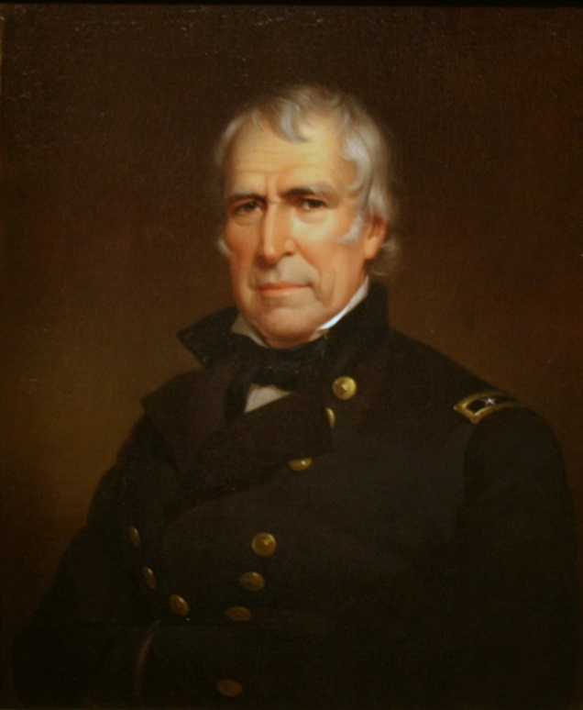
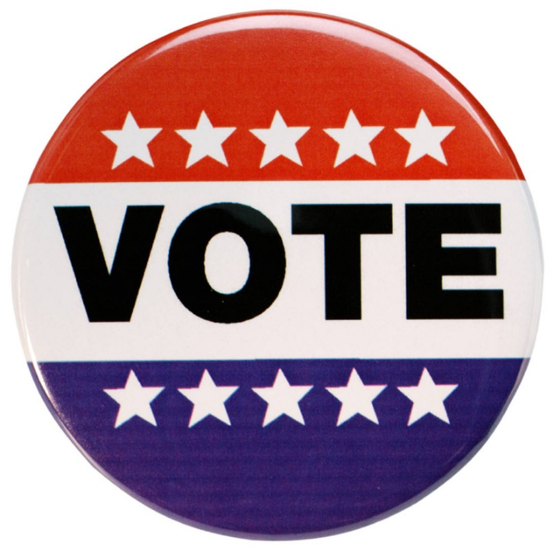
Sectionalism over Slavery: Ideas on How to Fix It??
Zachary Taylor’s solution – let the territories become states!
When western lands remained territories - Federal government was responsible for free vs slave status.
If they are states – each states determines the status of slavery themselves (Popular Sovereignty).
Basically, he didn’t want to deal with it - made the states deal with it.
The North’s Goal – stop the spread of slavery into the territories (only a minority wanted total abolition).
The South’s objection - new states would create a northern majority…
In 1849, there were 15 free and 15 slave states

Slide 9
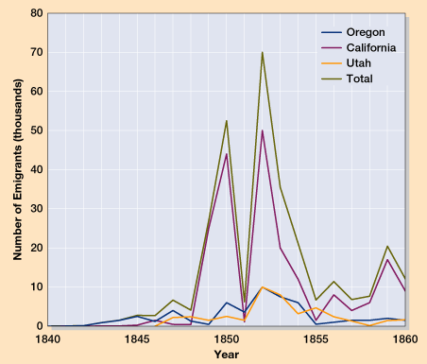
Western Movement Explodes – The Gold Rush!
1848 - traces of gold in the foothills of the Sierra Nevada.
Word spread to San Francisco, the east coast, and the rest of the world.
People worldwide flocked to CA to find gold – biggest year 1849.
1848 Cali. Pop = 14k
1852 Cali. Pop = 220k
Many “49ers” left families and jobs to head west…Mostly men - created a volatile society.
Word of gold reached China - large scale Chinese immigration to the US.
While some did, most people never found gold.
Created the “Wild West.”

Slide 10
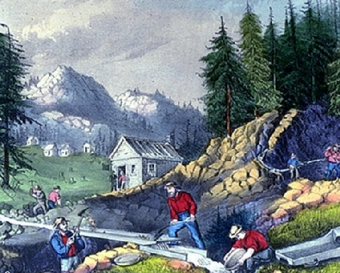
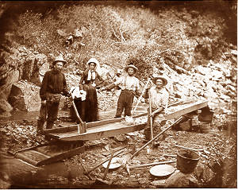
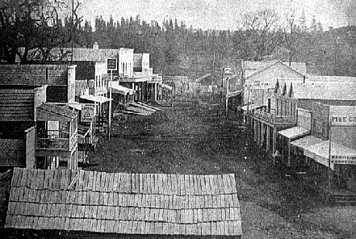
The Gold Rush Ushers in the Wild West!

Slide 11
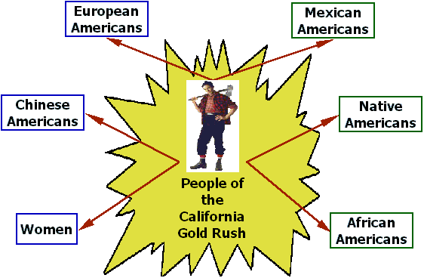
Sectionalism over Slavery Intensified
California’s population - increased exponentially due to the California Gold Rush (ironically, not a large amount of gold).
1849-1850 - apply for statehood as a free state.
The South - fearing the loss of power in the Senate, objected!
Northerners drafted petitions demanding the prohibition of slavery in the territories.
Southerners talked openly of secession!
Things are getting tense!

Slide 12
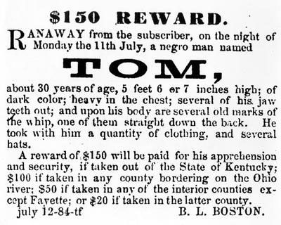
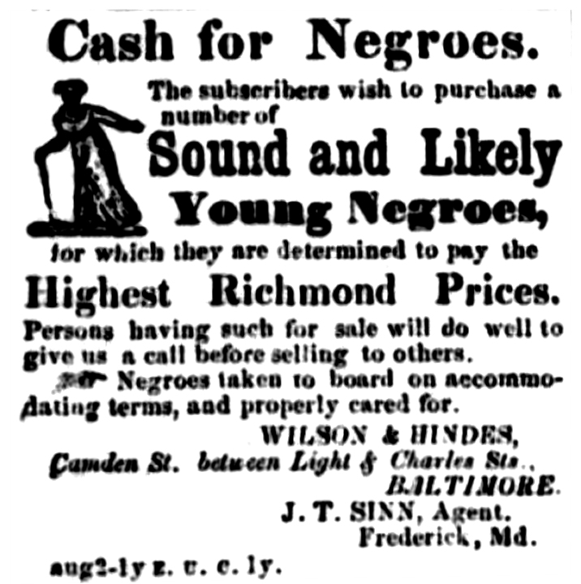
Sectionalism over Slavery Intensified
In addition, South is mad about the increasing loss of slaves (econ. loss!).
The Underground Railroad - provides an escaped slave a way to freedom (escape route to the North).
Aided by anti-slavery homes (stations) and abolitionists (conductors).
Remember, slaves are an economic investment in the south – increasing loss economic wealth!
Makes the south look weak - unable to control their slaves (happy slave image is destroyed).
Southerners call for stricter Fugitive Slave Laws!

Slide 13
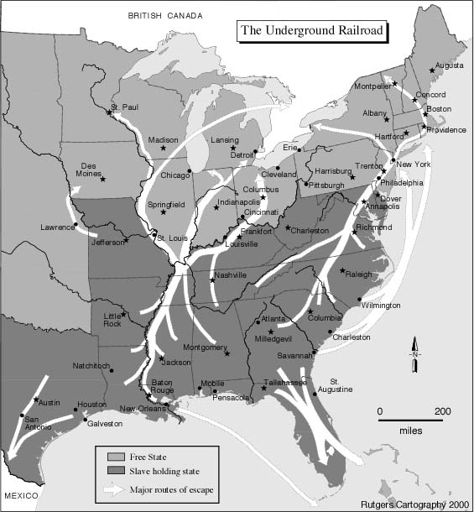
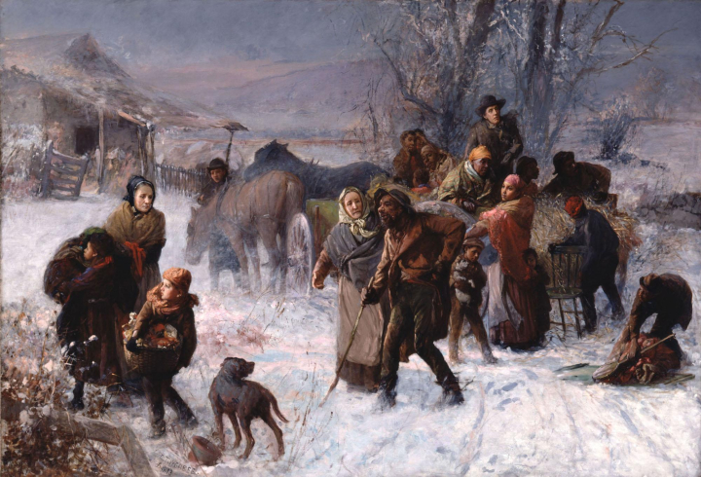
Underground Railroad

Slide 14
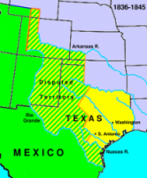
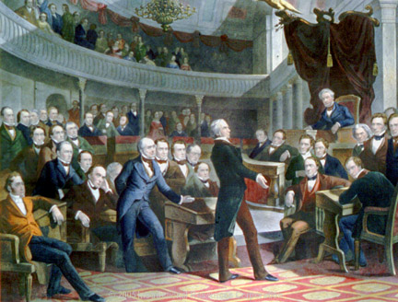
A Solution is Needed!
Sectional crisis – Senate tried to find compromise – it is a mess at this point!
Issues to Fix:
CA wants to be a state – most thought it would be slave due to most of the territory being under the 36-30 line, but Pres. Taylor wanted it as a free state.
Texas (slave state) is claiming NM lands for themselves.
Abolitionists want slavery out of DC.
South is mad at North for not enforcing the Fugitive Slave Act of 1793.
Henry Clay - presented a bill that contained:
Admission of California as a free state.
Forming territorial governments without restrictions on slavery.
Eliminate the slave trade in DC, but not slavery itself.
A more effective fugitive slave law.

Slide 15
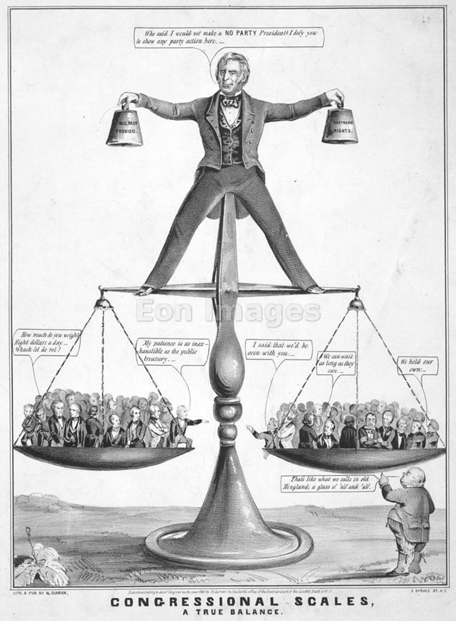
Solution: The Compromise of 1850
Debate raged for months (Congress/nationwide).
Congress - two phases (reveals the changing politics in the 1850’s).
Phase 1: dominated by older leaders (Henry Clay, John C Calhoun, and Daniel Webster).
Resembled founders like Jefferson, Adams….they were searching for compromise based upon ideals and ultimate unification.
Phase 2: dominated by younger leaders (William Seward, Jefferson Davis, and Stephen Douglas).
Union was less important to them than practicality, their personal objectives, and economic self interest.
July 1850 - President Taylor died suddenly - Millard Fillmore became president.
Helped the Compromise of 1850 pass Congress.

Slide 16
The Compromise of 1850
End Result:
Henry Clay (passed by Stephen Douglas) comes up with the final Compromise of 1850:
1. CA as Free State.
2. TX and NM – TX paid 10M to give up disputed lands.
3. No sale of slaves, but slavery still exists in DC.
4. Fugitive Slave Act made harsher (requiring people to turn in escaped slaves or they are jailed or fined).
5. Popular sovereignty in the NM/UT Territories
Eases the issue – however, still DEEP tensions between the North and South.

Slide 17
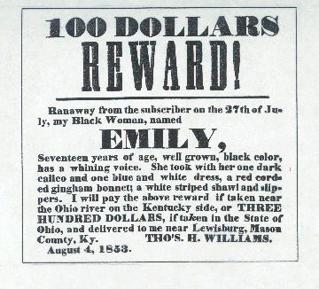
Fugitive Slave Act

Slide 18
Compromise of 1850

Slide 19
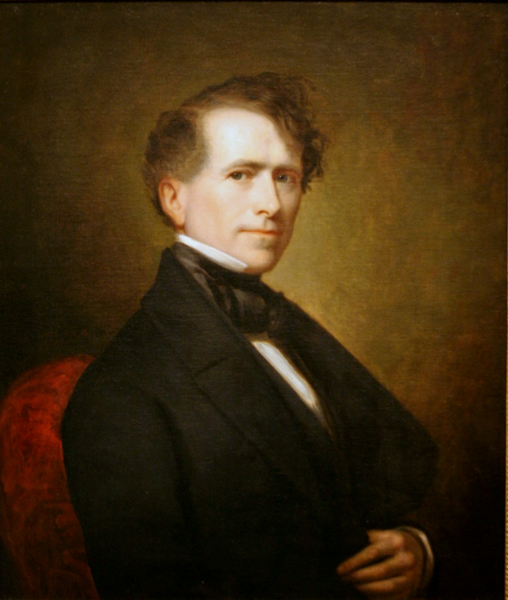
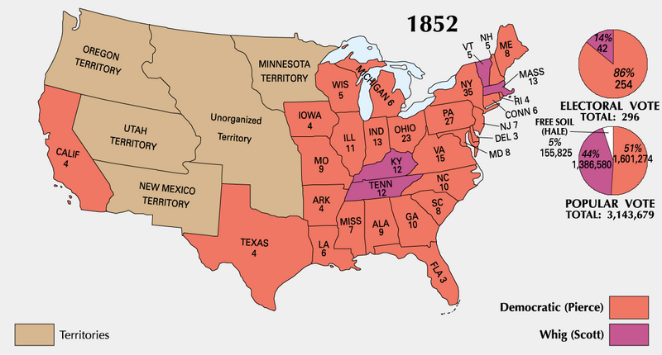
Election of 1852
Both major parties endorsed the Compromise of 1850 - still a part of the election.
Democrats nominate Franklin Pierce.
Whigs nominate General Winfield Scott.
Sectional debate primarily victimized the Whigs (mass defections to anti-slavery groups) - helped Pierce win.
Illustrates the eventual downfall of the Whig Party.
Pierce attempted to maintain national harmony (impossible task).
Fugitive Slave Act - ignored in the north (mobs in some Northern cities to prevent enforcement of the law).
Southerners enraged - Compromise was now worthless for the south.

Slide 20
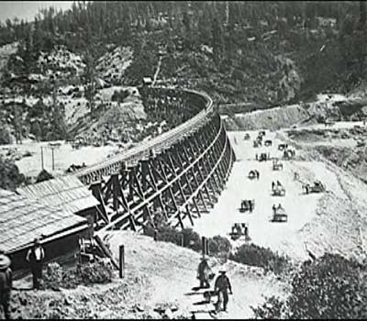
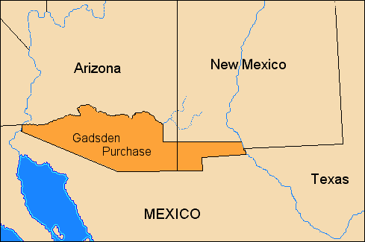
Expansion and Sectionalism
White settlement west - Miss R. to Great Plains.
Transportation and communication needed - caused broad support to build a transcontinental railroad.
West most point - California
East most point – Which city? (Chicago, New Orleans, St. Louis, Memphis???).
Northerners favored Chicago - Southerners favored the other cities.
Became part of the sectional struggle!
1853 – Gadsden Purchase – added land (bottom part of NM and AZ) – current border line to build the Transcontinental RR.

Slide 21
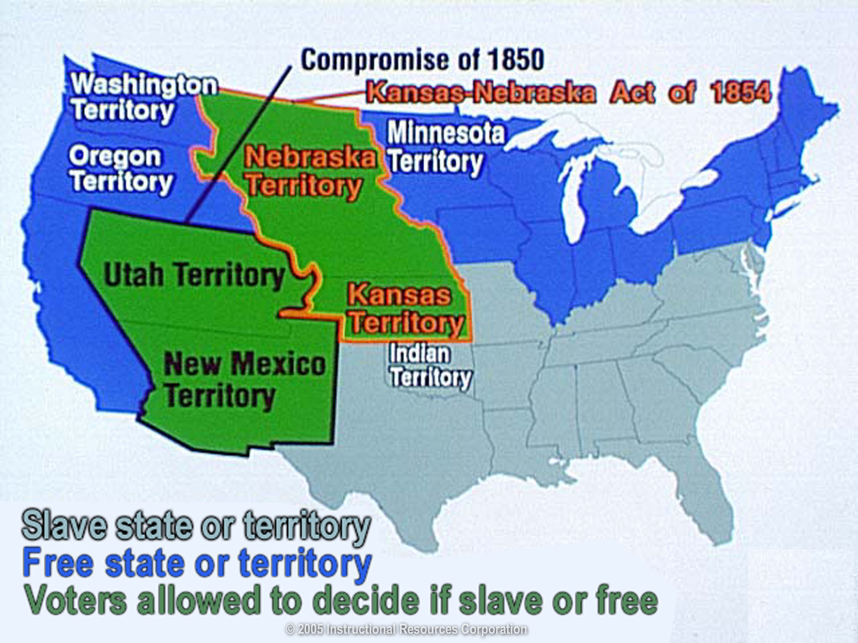
The Kansas-Nebraska Act
Stephen Douglas (Illinois senator) - wanted the railroad to go thru Chicago.
1854 - introduced a bill to organize a territory (Split a large chunk into two pieces – Kansas and Nebraska).
Nebraska territory - railroad could run through.
South would oppose the bill – so…included a provision to let the new territory decide for itself the status of slavery (popular sovereignty).
Ended the Missouri Compromise (Nebraska above the 36-30 split).
South was happy and the northern abolitionists were upset – slavery is now allowed to grow!
Violence and conflict to come!

Slide 22
Reaction to the Acts
Southern leaders supported it because they assumed Missouri farmers with slaves would move across the border.
President Franklin Pierce supported the bill and pushed it through Congress.
Northerners were unhappy with the decision.
Said Missouri Compromise had already banned slavery in the area and that this repealed that act.
Some protested by openly challenging the Fugitive Slave Act

Slide 23
“A living, creeping, lie.”
"If Kansas should sink to-day, and leave a great vacant space in the earth's surface, this vexed question [of slavery] would still be among us.“
A. Lincoln

Slide 24
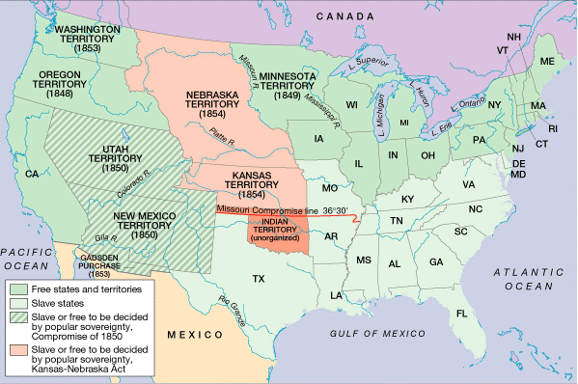

Slide 25
Impact of the Kansas Nebraska Act
Proslavery people and the Antislavery people started to fight with each other over the issue of slavery
The Proslavery men wanted to vote to make sure Kansas would become a slave state
The Antislavery people wanted to vote to make sure Kansas would become a free state
Freesoilers came to Kansas in hopes of making Kansas a free state
Notes:
The two groups of people hated each other because of their view of Slavery. Explain the terms of Pro-slavers and

Slide 26
